Slide 1

ECE 530 Cloud Computing
Ioannis Papapanagiotou
Examples - UI Driven Serverless

Slide 2
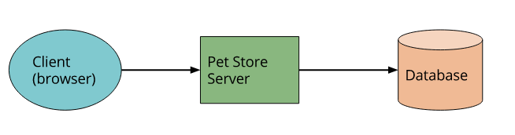
UI driven application: The Classic Design
A traditional 3-tier client-oriented system with server-side logic. A good example is a typical ecommerce app (dare I say an online pet store?).
For example implemented in Java on the server side, with a HTML / Javascript component as the client
With this architecture the client can be relatively unintelligent, with much of the logic in the system - authentication, page navigation, searching, transactions - implemented by the server application.

Slide 3
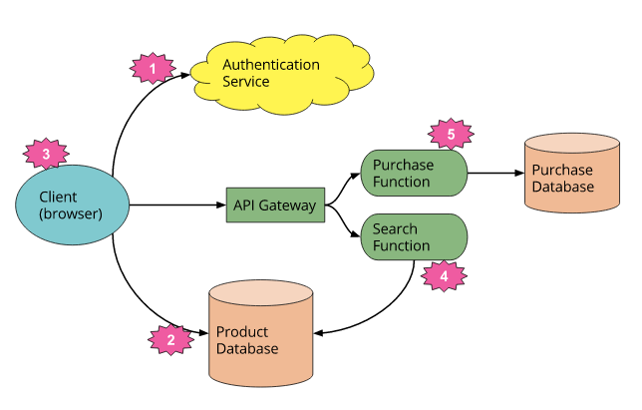
Serverless redesign for the Pet Store
Deleted the authentication logic replaced it with a third party BaaS service.
Client can have direct access to a subset of our database (for product listings), which itself is fully 3rd party hosted (e.g. AWS Dynamo.)
Likely to have a different security profile for the client accessing the database in this way from any server resources that may access the database.

Slide 4
A Serverless view
These previous two points imply a very important third - some logic that was in the Pet Store server is now within the client,
E.g.: keeping track of a user session, understanding the UX structure of the application (e.g. page navigation), reading from a database and translating that into a usable view, etc. The client is in fact well on its way to becoming a Single Page Application.
Some UX related functionality can be kept in the server,
if it’s compute intensive or requires access to significant amounts of data. An example here is ‘search’.
For the search feature instead of having an always-running server we can implement a FaaS function that responds to http requests via an API Gateway (described later.) We can have both the client, and the server function, read from the same database for product data.

Slide 5
A Serverless view (cnt’d)
Since the original server was implemented in Java, and AWS Lambda (our FaaS vendor of choice in this instance) supports functions implemented in Java, we can port the search code from the Pet Store server to the Pet Store Search function without a complete re-write.
Finally we may replace our ‘purchase’ functionality with another FaaS function, choosing to keep it on the the server-side for security reasons, rather than re-implement it in the client. It too is fronted by API Gateway.

